Slide 1
Integrative Project (Pi)
Lucas augusto HARTMANN

Slide 2
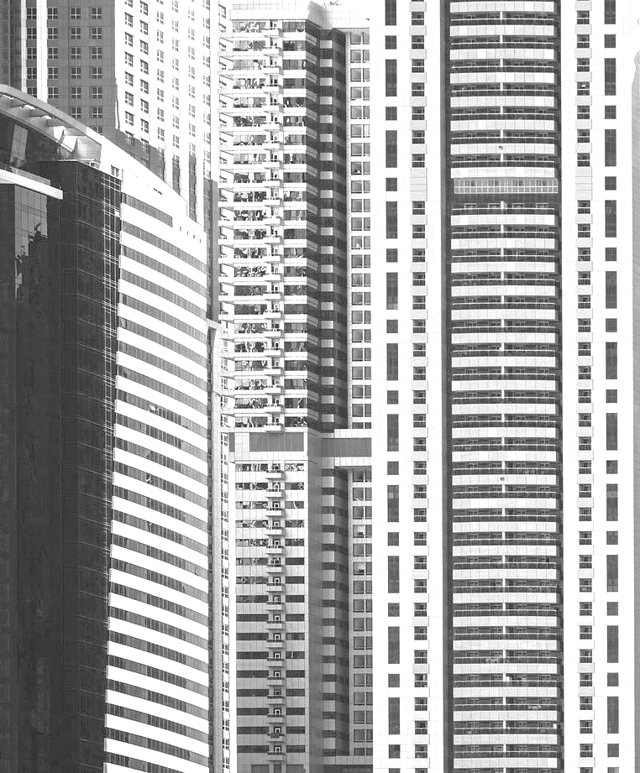
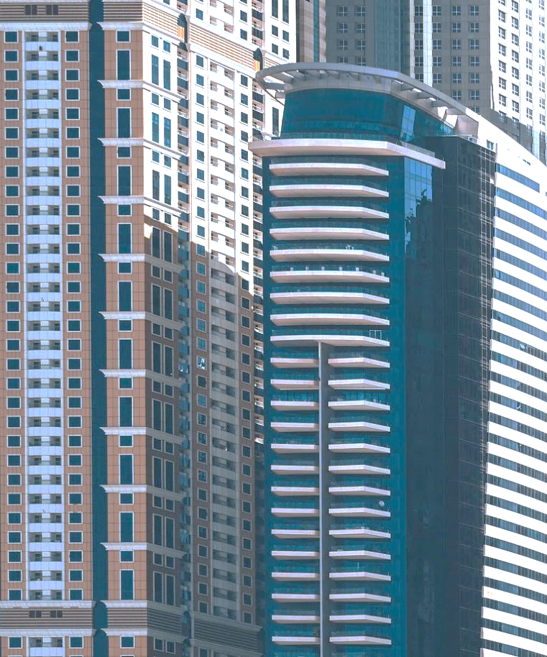
Summary
Introduction
About the Project/Project Overview (Product)
WHY/Problem and Solution
Target Audience
OBJECTIVE
TIMELINE
Next Steps

Slide 3
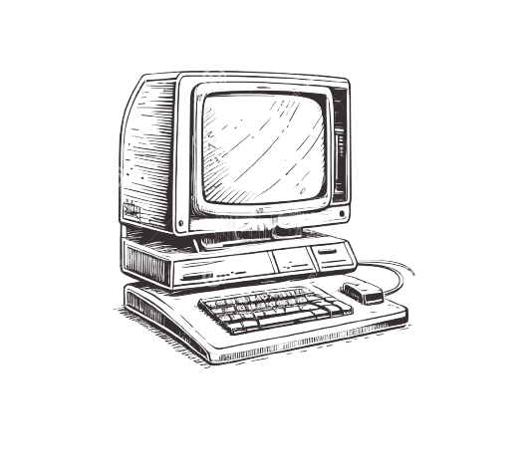
Introduction
Lucas Augusto Hartmann, 22 years old
Enrolled at Senac Tech, studying Systems Development
I have been studying programming since 2020
I joined Senac in 2024.

Slide 4
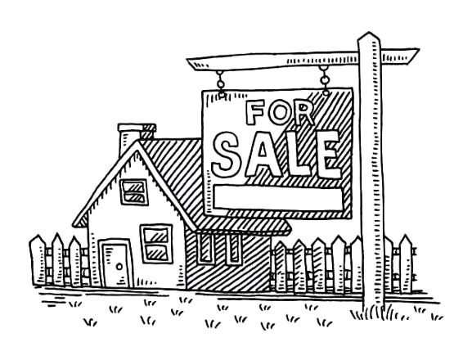
About the project
Real Estate Management System / Software for Real Estate Agencies
Create, Read, Update, Delete
Clients, Properties such as Apartments, Shops, Lofts, Houses, Warehouses.
Company Information: how much money was earned this month, this year... How many clients, how many employees.

Slide 5
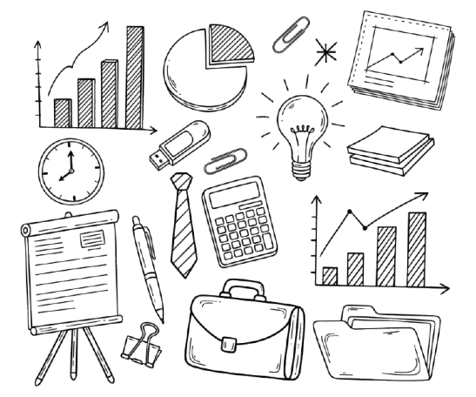
Why
The software I use for my work has flaws.
Relatives who are freelancers or business owners.
Product: consulting company, he has clients, he wants to know about his company.

Slide 6
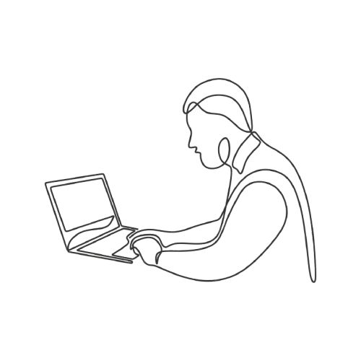
Objective
Gain experience
Use my experience to try to build better software for the companies I work with, or at least my own software, with my design choices
Build my best software yet
Impress companies

Slide 7
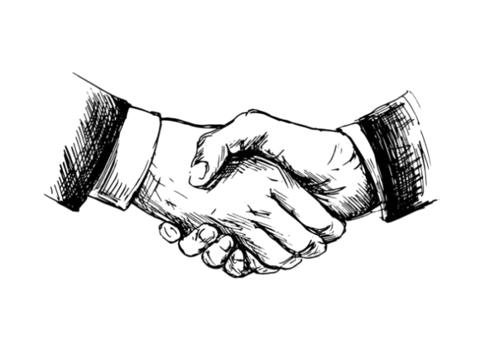
Target Audience
Real estate companies
Any company, as my software can be adapted or I can create another one
Freelancers
People who own a company

Slide 8
TIMELINE
MAY 2025 | I made more diagrams and sketches of what the program's interface would look like.
JUL 2025 | I started programming the interface.
AUG 2025 | I modeled the database based on the diagrams I had made.
SEP 2025 | I started implementing the database by connecting to the code I had written.
OCT-NOV 2025 | I'm working on improving the interface and starting the project documentation.
NOV 2024 | I decided on the topic for the integrative project.
DEC 2024 | I decided what the project entities would be. The entities that would be the classes in the code.
FEB 2025 | I created diagrams to better plan the project.
MAR 2025 | I started the code by creating the entity classes.
APR 2025 | I continued working on the code.

Slide 9
Next Steps
Interface
Create a better interface. A more beautiful one with a better user experience.
Code
Make the code more readable and efficient. Clean up the code.
Documentation
I need to start the documentation. Update the diagrams about my project.

Slide 10
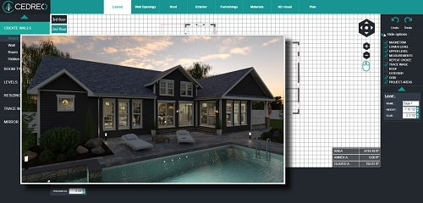

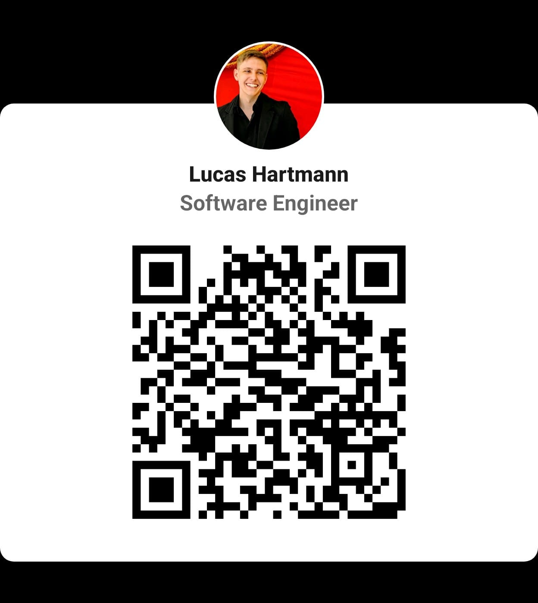
Thank you
lucashartmann

